Slide 1
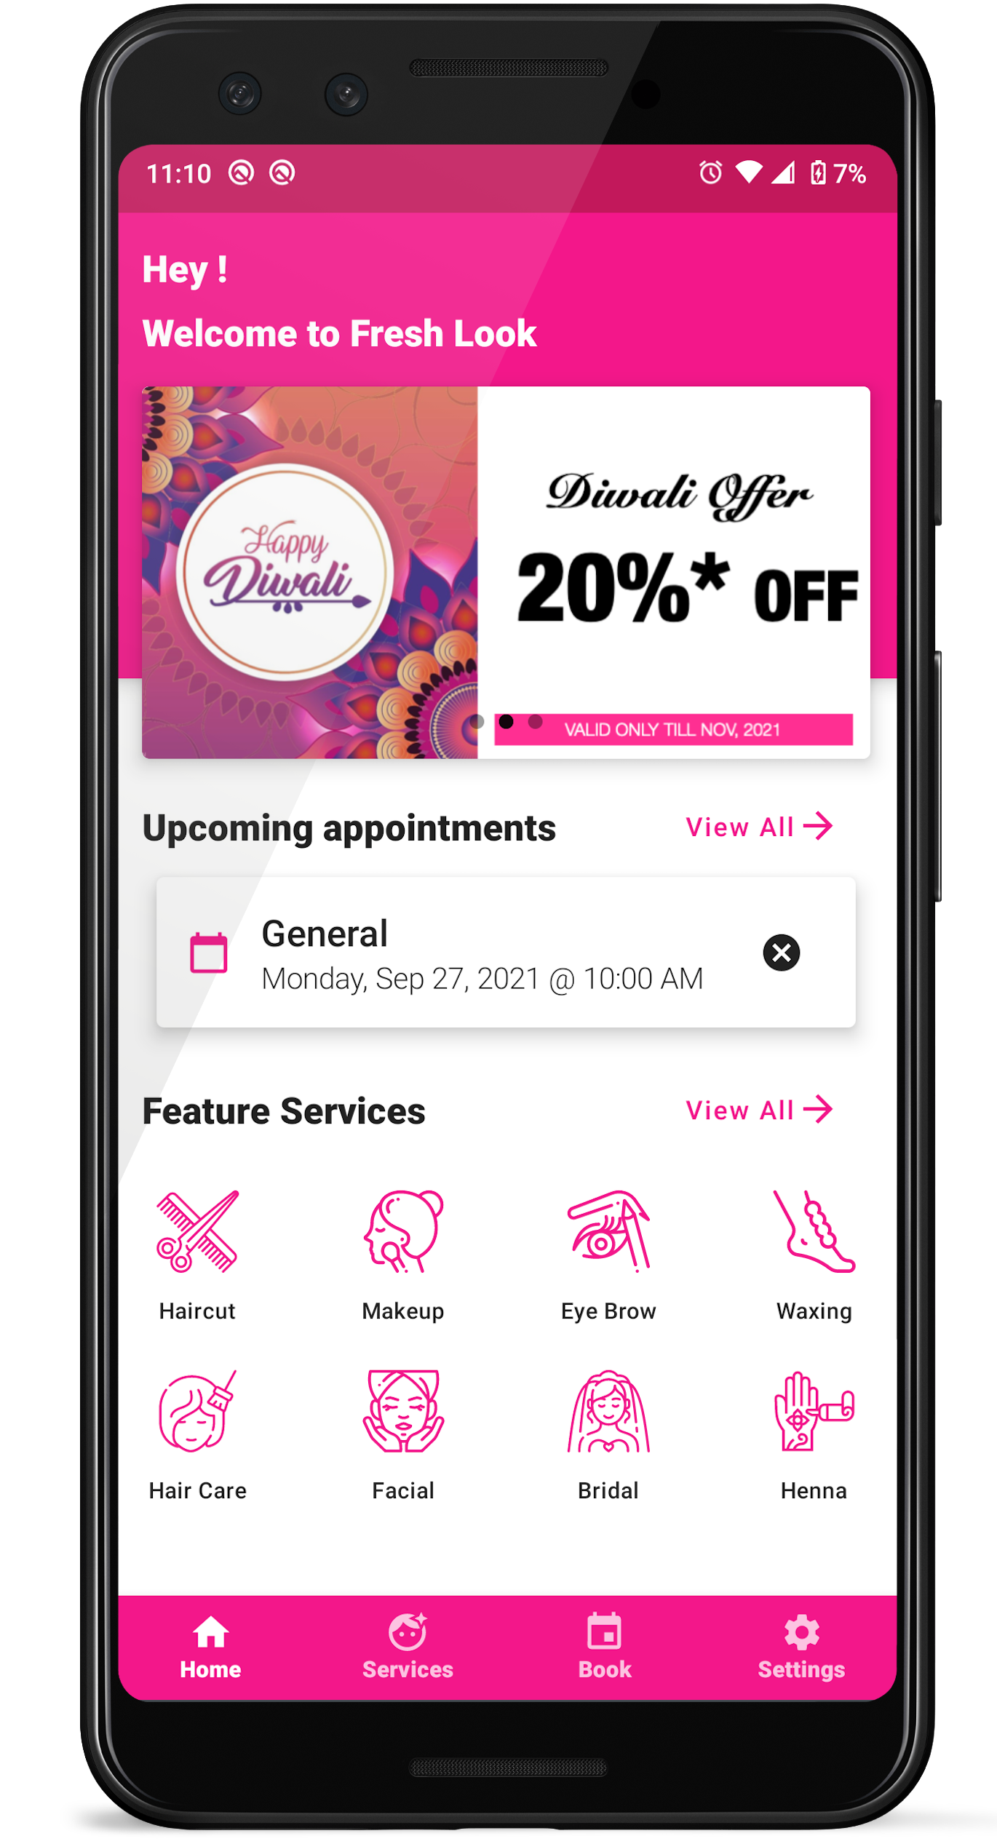
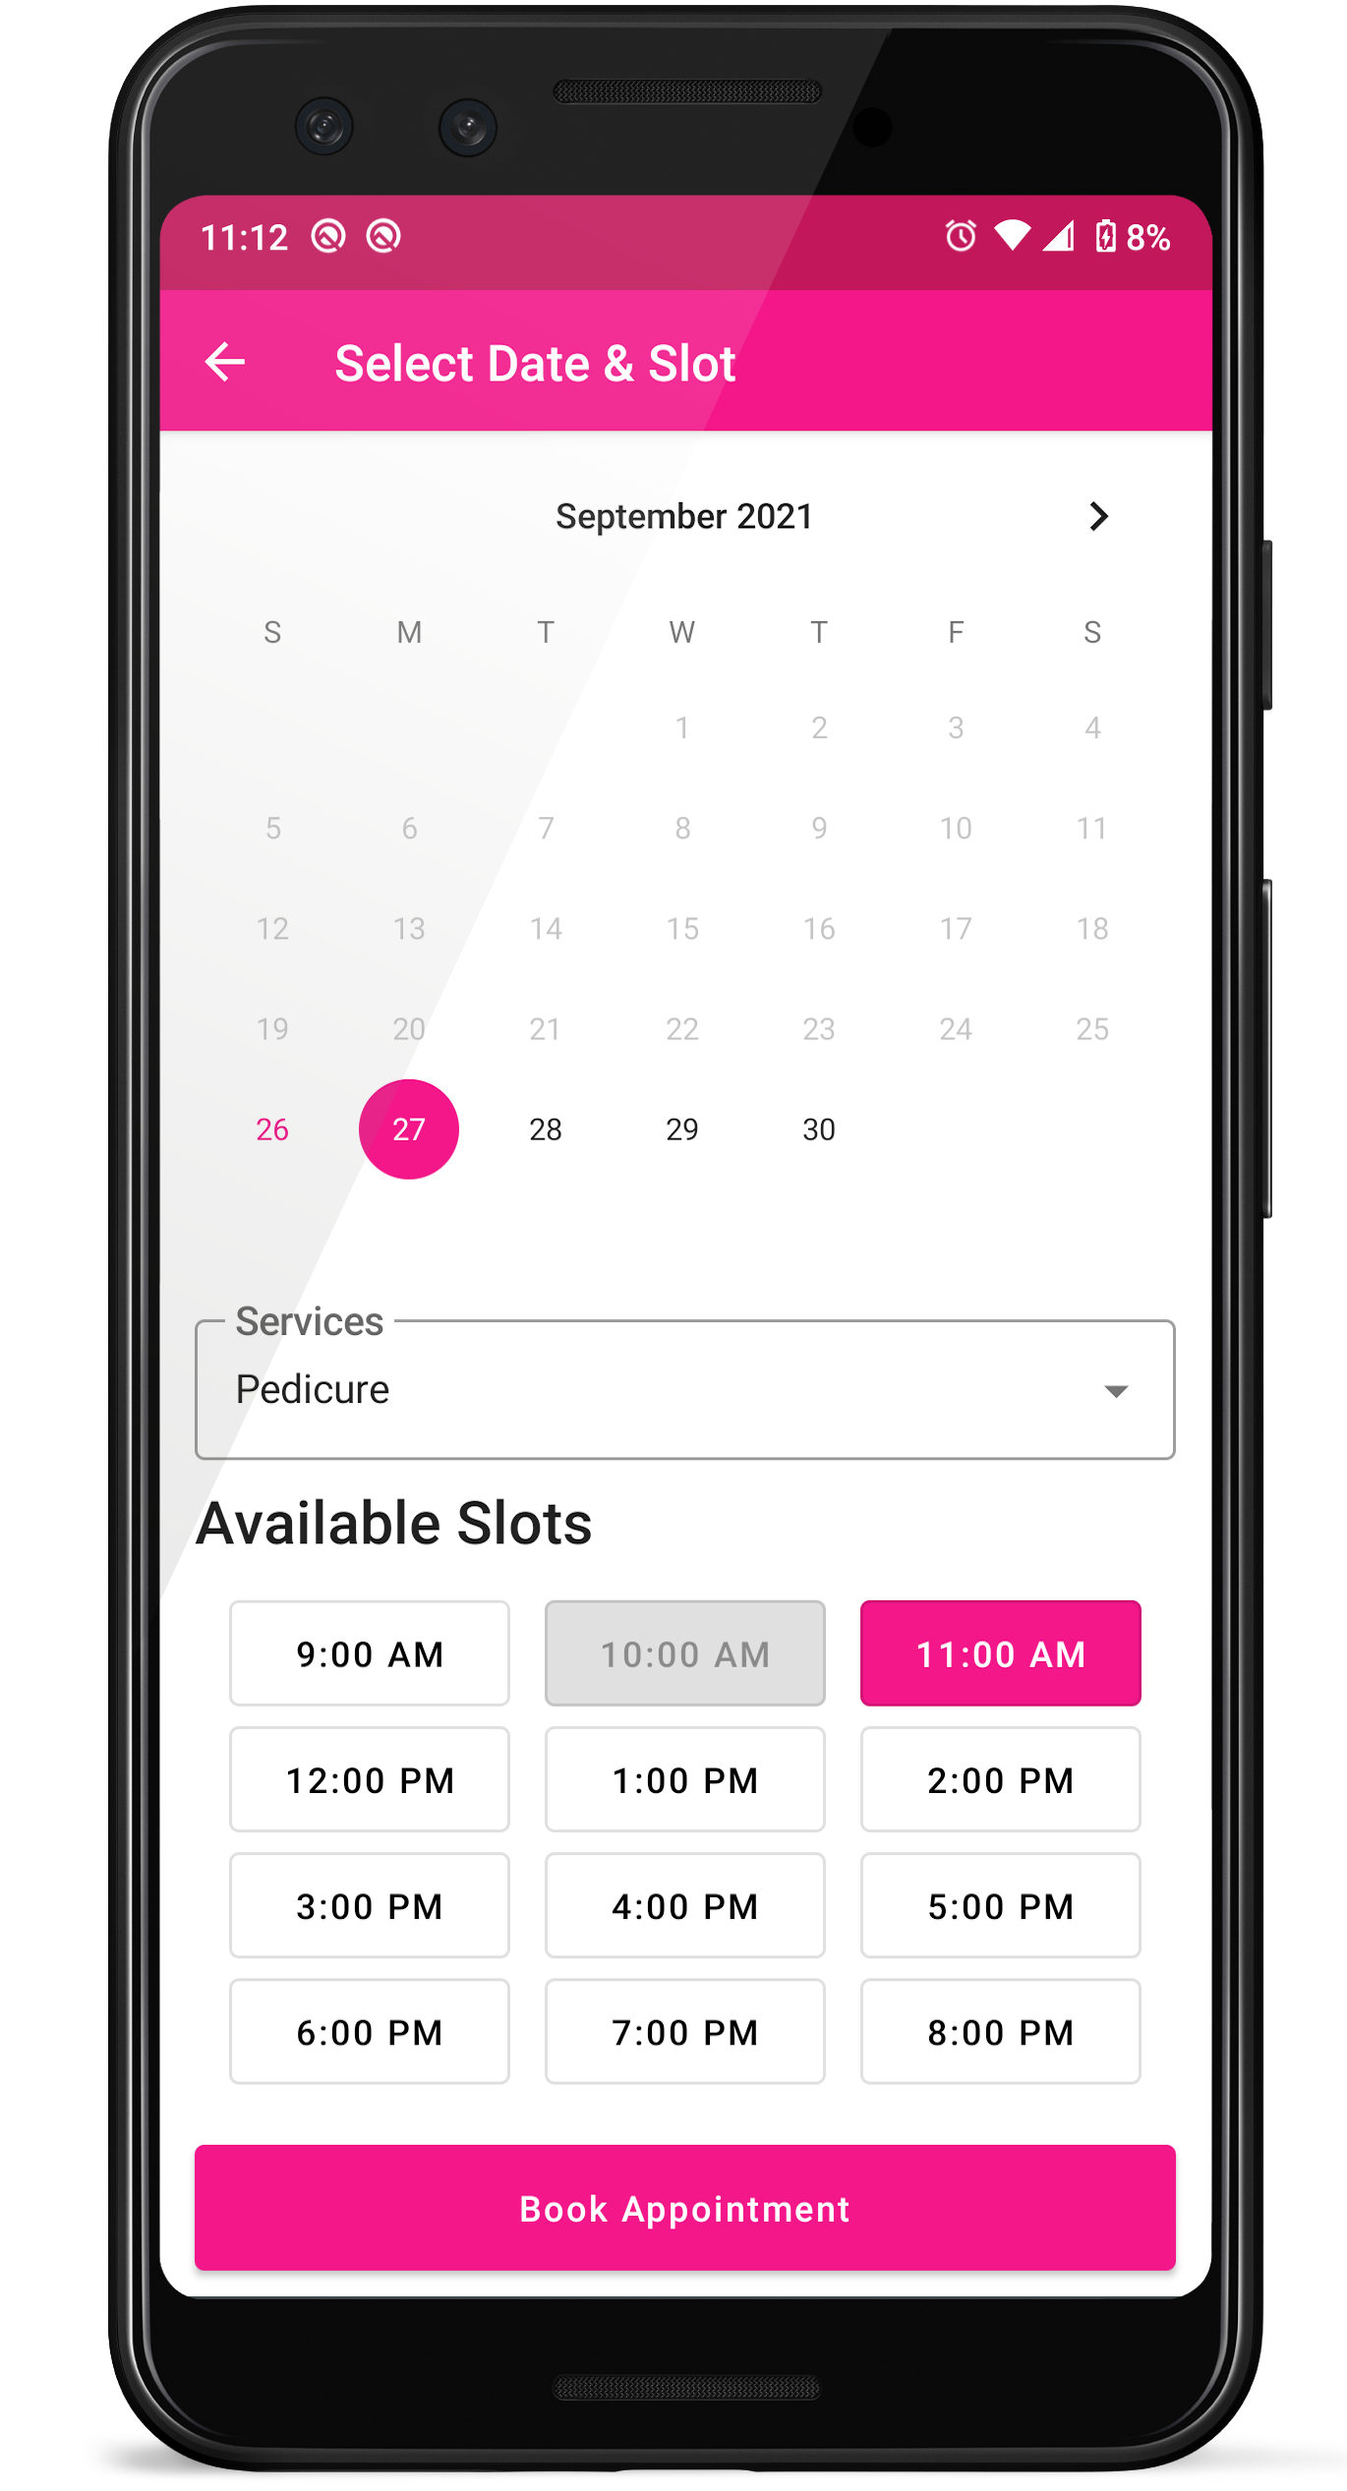
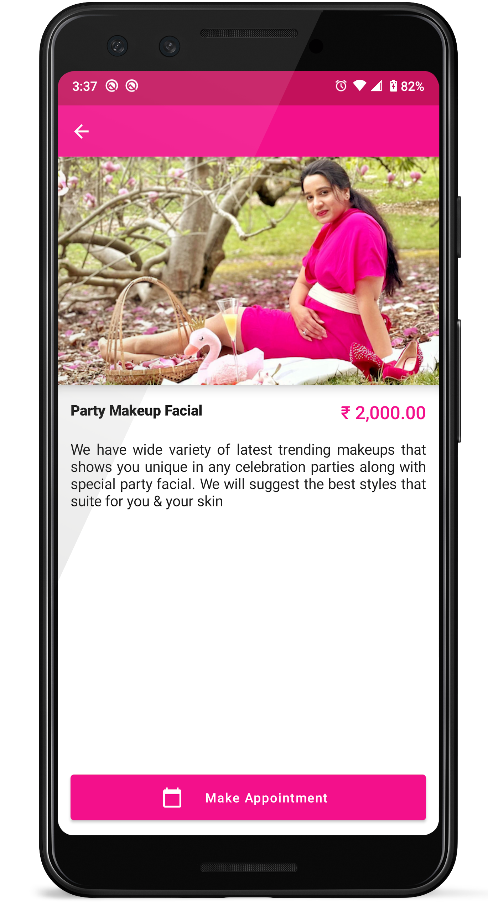

INTUITIVE DESIGN
Elegant Dashboard
Offers!
Appointments!
Information!
We Care
Yours Skin
Fresh Look
Beauty Parlor

Slide 2
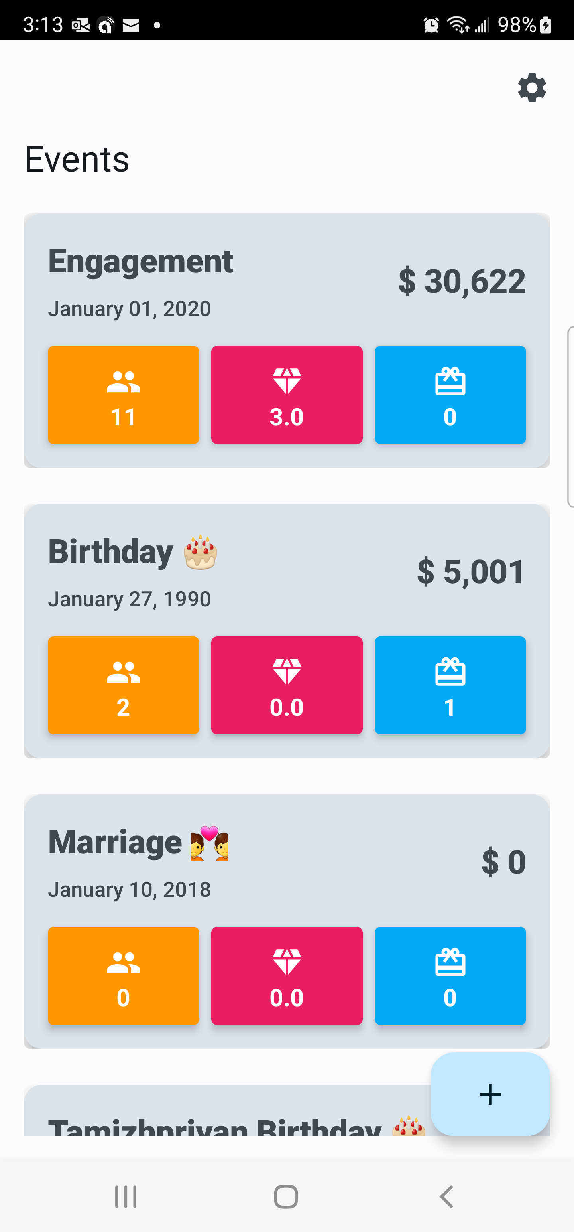
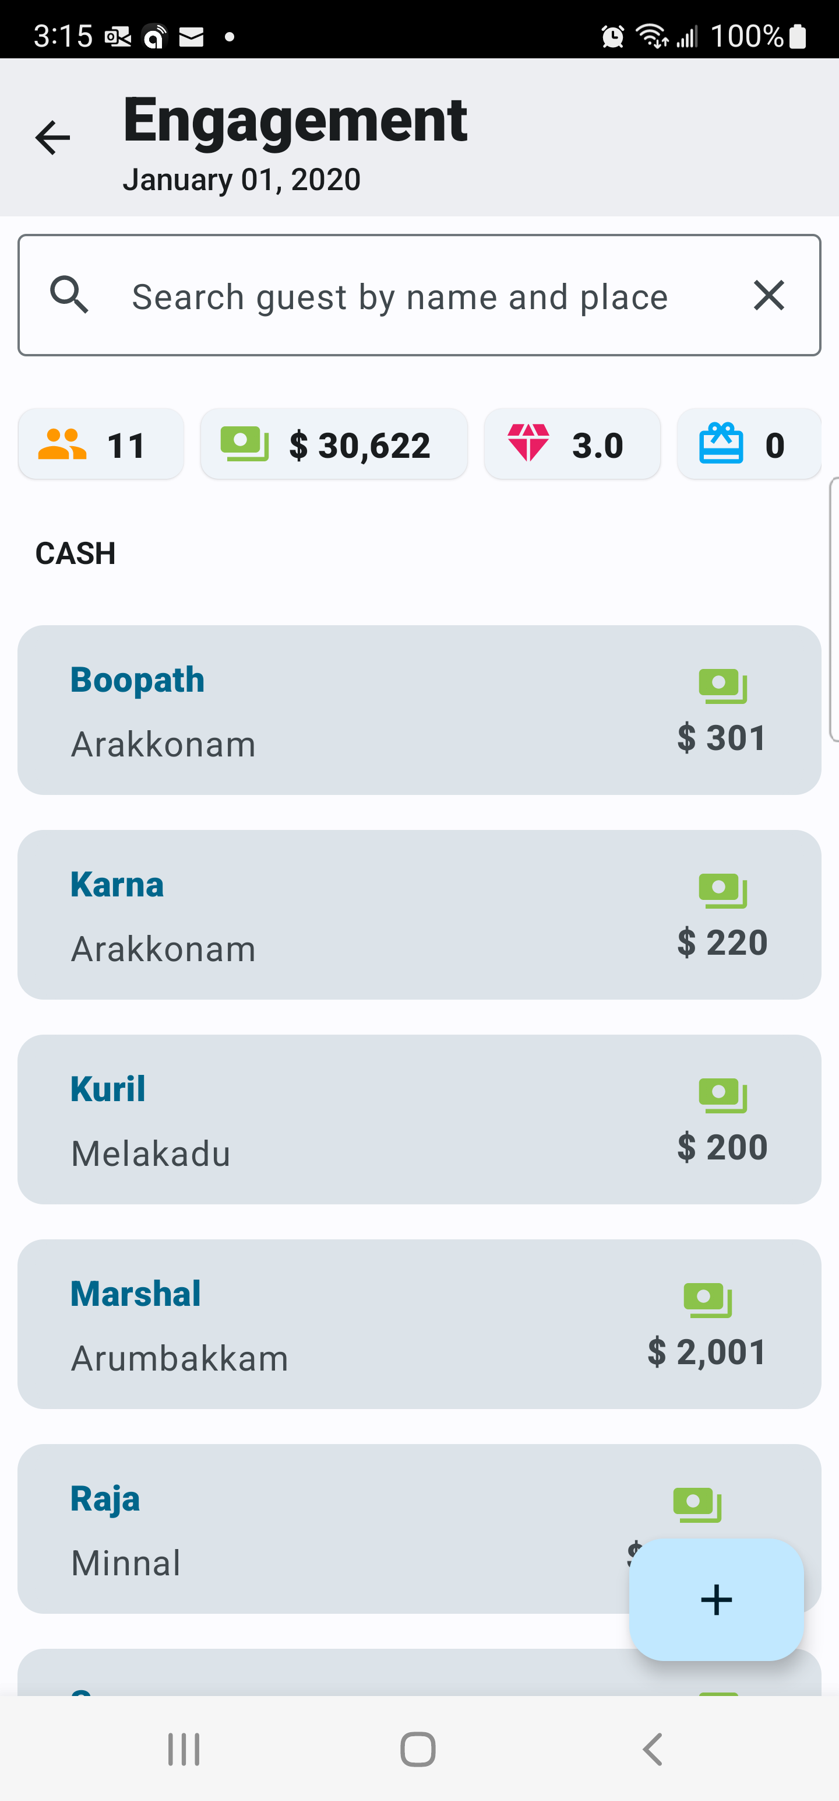
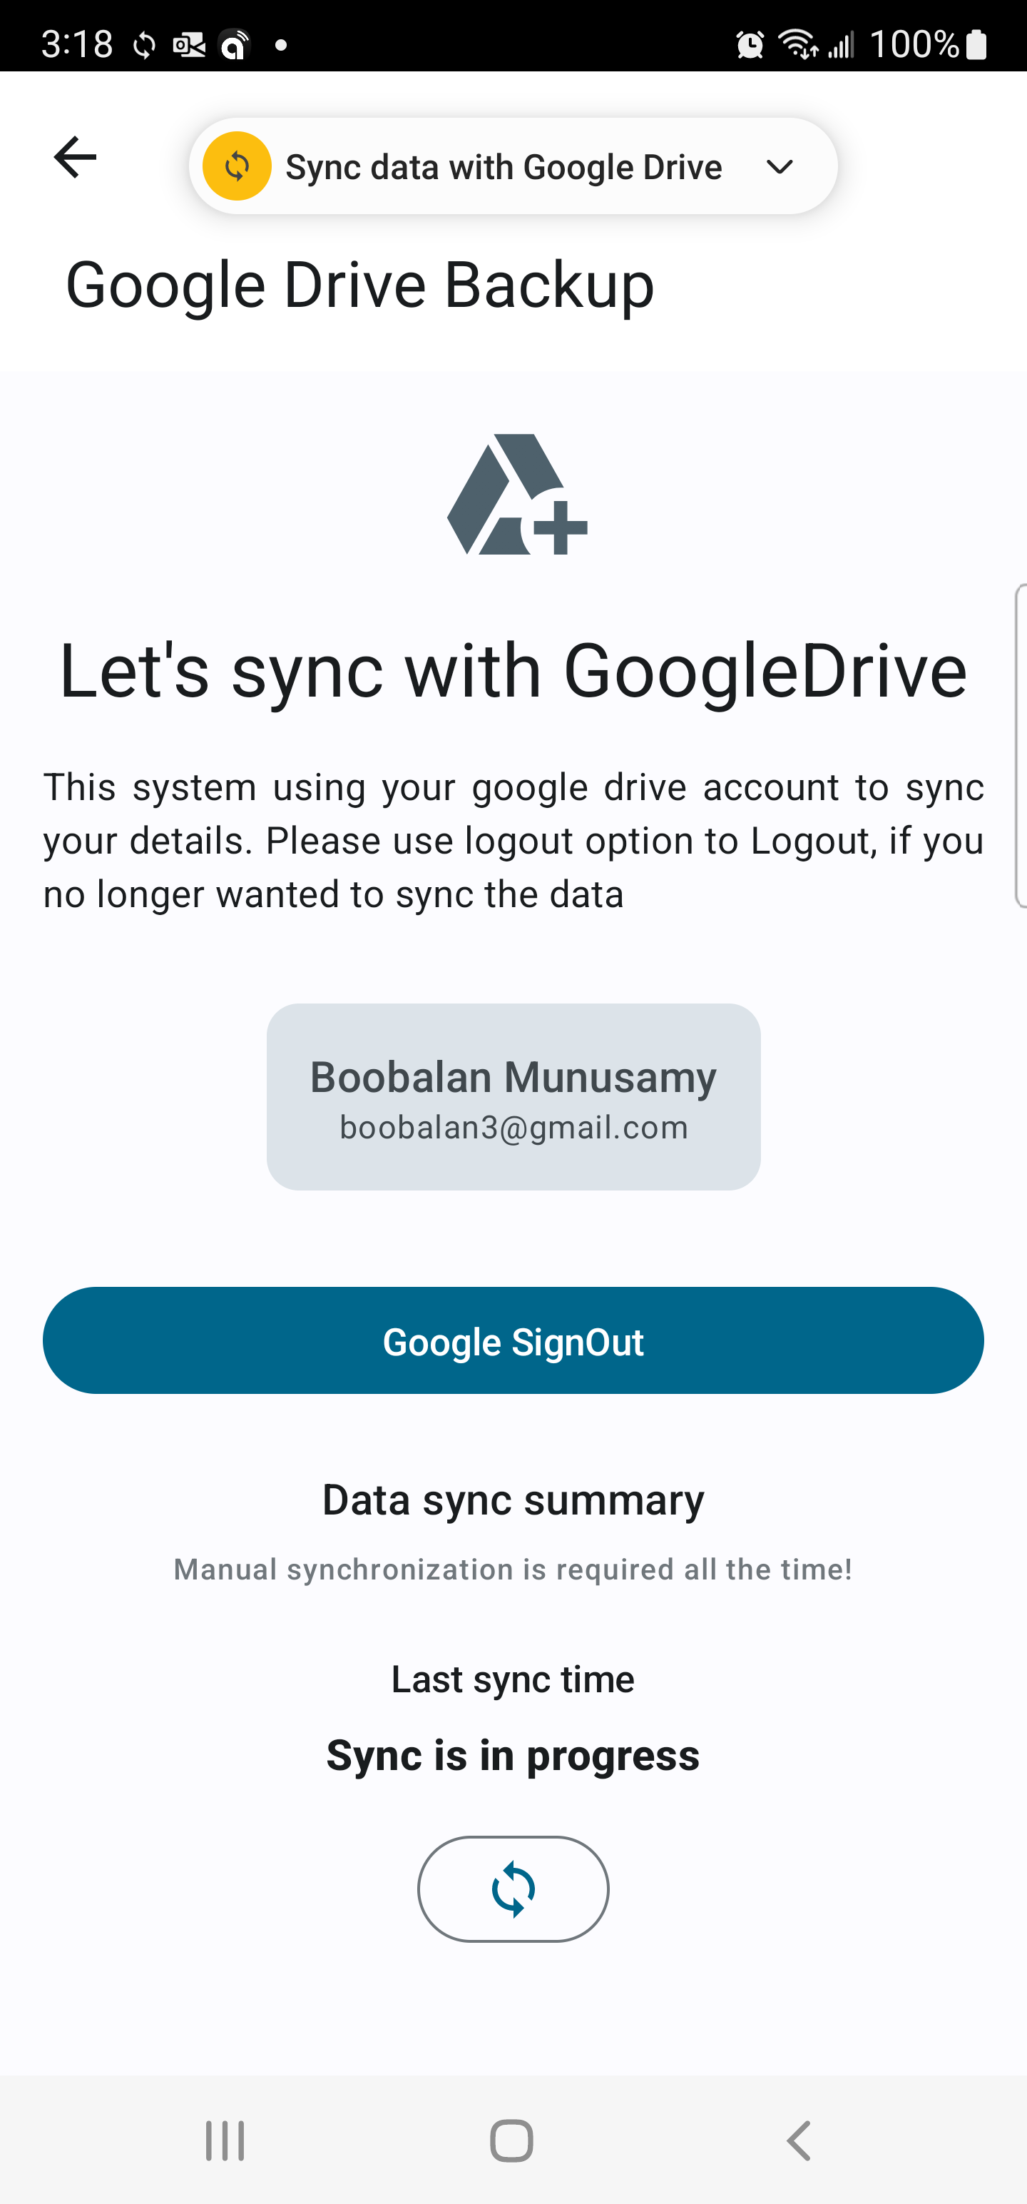

Register
Event Dashboard
Guest Dashboard
Google Drive SYNC
Moi App (Gift Register)
DIGTAL WAY TO STORING GIFT DETAILS!

